Slide 1
SENTIMENT BASED MOVIE REVIEW SYSTEM
TECHNOLOGY STACK
FRONT-END MIDDLEWARE BACK-END
HTML5,CSS3,BOOTSTRAP PHP MYSQL, Python
ALGORITHM IMPLEMENTED:
K- NEAREST NEIGHBOUR ( KNN )

Slide 2
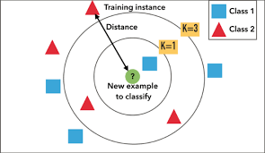
An example for K-Nearest Neighbour

Slide 3
Primary Goals
To Provide a Comments based review for a movie website rather than providing ratings based on individual elements like casting, songs , cinematography and a few miscellaneous things.
It provides only authenticated users to comment their views on the movies, such that fake reviews can be prevented.

